Slide 1
A NOVEL APPROACH FOR DETECTION AND CLASSIFICATION OF FISH SPECIES
IEEE ICEEICT 2023
Darshana Durgamahanty
Department of Computer Science and Engineering
Amrita School of Engineering, Chennai, India

Slide 2
AGENDA
Introduction ……………… 3
Motivation ……………… 4
Main Objective ……………… 5
Literature Survey ……………… 6
Limitation in Previous Approach ……………… 7
Proposed Work ……………… 8
Research Result ……………… 12
References ……………… 14

Slide 3
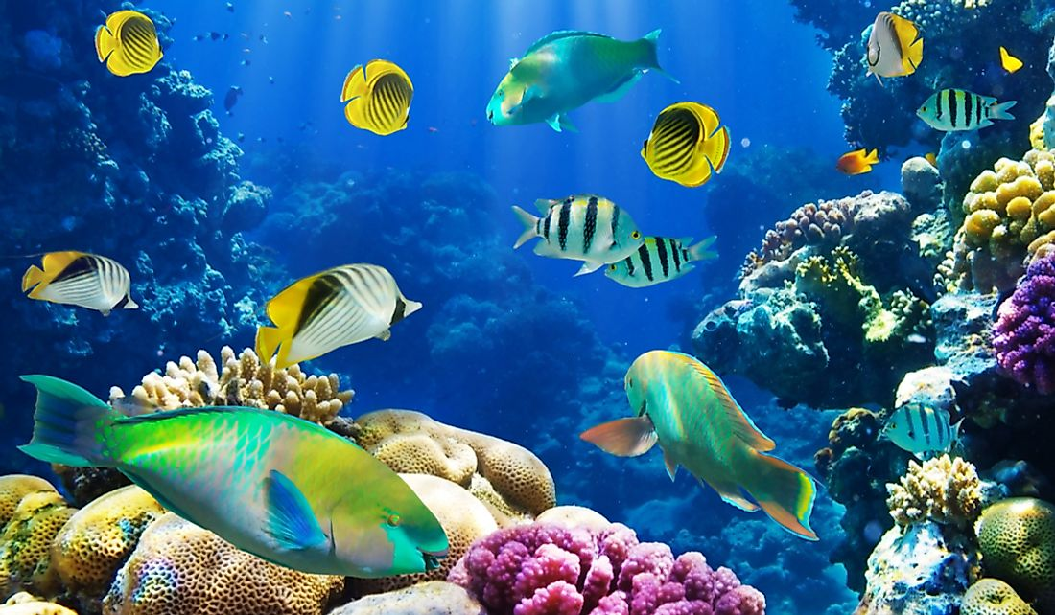
INTRODUCTION
The process of detecting and classifying fish species and families based on their characteristics is known as “Fish Species Detection and Classification”.
This knowledge is crucial for protecting the environment and for creating sustainable fisheries for human use.
Uses the similarity to the representative specimen image to identify and classify the target fish into species. This advances the understanding and prediction of how fish react to environment changes, habitat deterioration, and fishing pressure.

Slide 4
II. MOTIVATION
Use of Optimal Algorithm
Improvised Accuracy
Efficient Data Processing

Slide 5
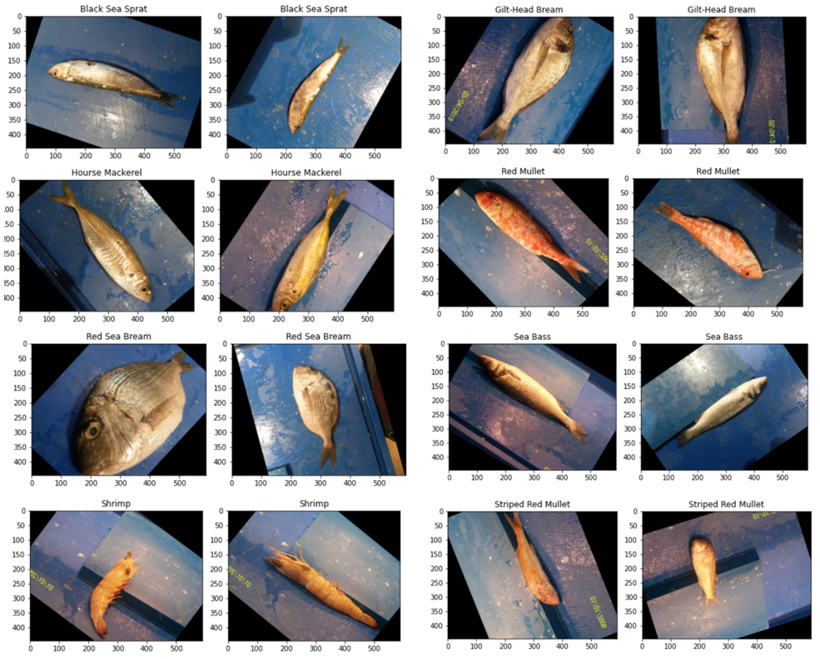
III. MAIN OBJECTIVE
To assist fishermen in understanding the fish species, and the preservation of our marine resources by promoting sustainable fishing practices.
To help investigators, nature conservationists: providing dependable source of information to those who are particularly concerned with the precise identification of fishes such as detect, classify them based on their features, giving scientific and common names

Slide 6
IV. LITERATURE SURVEY
Author | Year | Methodology | Dataset | No. of fish families | Accuracy
Alsmadi et al | 2011 | Back Propagation Algorithm | GIS dataset | 24 | 86%
Kaya et al | 2018 | ANN | F4K dataset | 3 | 91.8%
Hernandez-Serna and Jimenez-Segura | 2014 | CNN | Self-collected | Not Reported | 91.65%
Qin et al | 2016 | Linear SVM | F4K dataset | 23 | 88.5%
Rachmatullah and Supriana | 2018 | Fish CLEF 2015 | CNN | 15 | 86%
Chen et al | 2017 | NCFM dataset | CNN | Not Reported | 70%

Slide 7
V. LIMITATION IN PREVIOUS APPRAOCH
BP algorithm is sensitive to noisy data and irregularity. It also requires large amount of time to train the model.
ANN require high processing time for big neural networks. Difficult to set correct configuration for the node numbers and layer numbers in various layer.
Integrating the global shape constraints into the architecture of CNN to entirely utilize the deep model’s power would be of concern research direction.
Linear SVM which is not suitable for large dataset. Doesnt perform well in noisy conditions

Slide 8
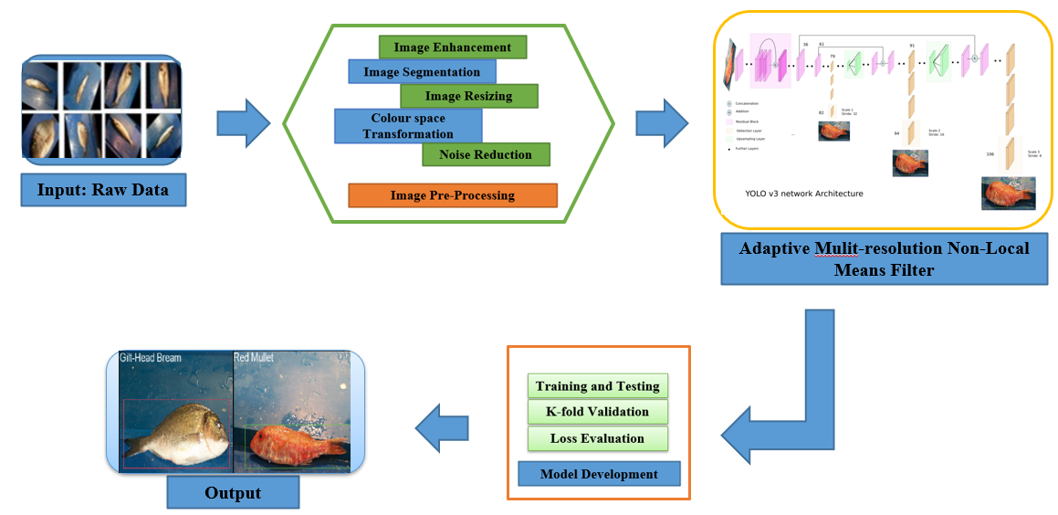
VI. PROPOSED WORK

Slide 9
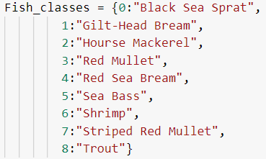

VI. PROPOSED WORK
Details of the dataset:
9 classes of “A large scale fish dataset”:

Slide 10
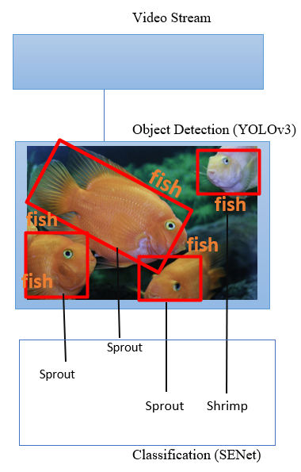
VI. PROPOSED WORK
Proposed 2-step Deep Learning Approach:
Video frames or images is sent into object detection component, YOLOv3 [You Only Look Once].
YOLOv3 is a pre-trained on ImageNet and fine-tuned for detecting moderate fish species using a custom dataset this component detects the presence of fish in a single video frame and moves the rectangular subframes with fish to a classification component built on a CNN-SENet structure.

Slide 11
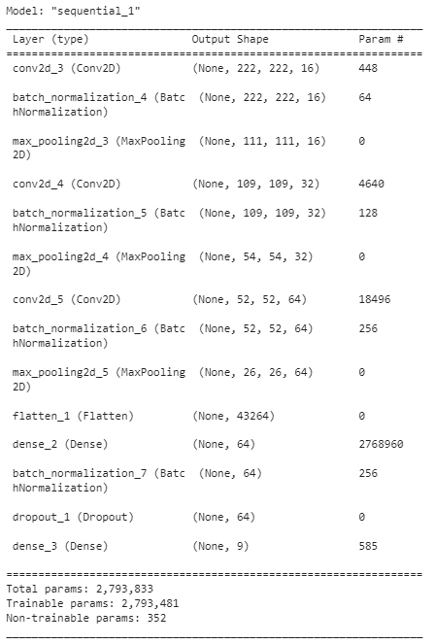
VI. PROPOSED WORK
Proposed 2-step Deep Learning Approach:
Categorising/Classifying the fish species, belonging to each species in each frame using CNN model with SE [Squeeze & Excitation] Architecture.
Add parameters to every convolutional block channels so that network could modify the weight of every feature map adaptively.

Slide 12
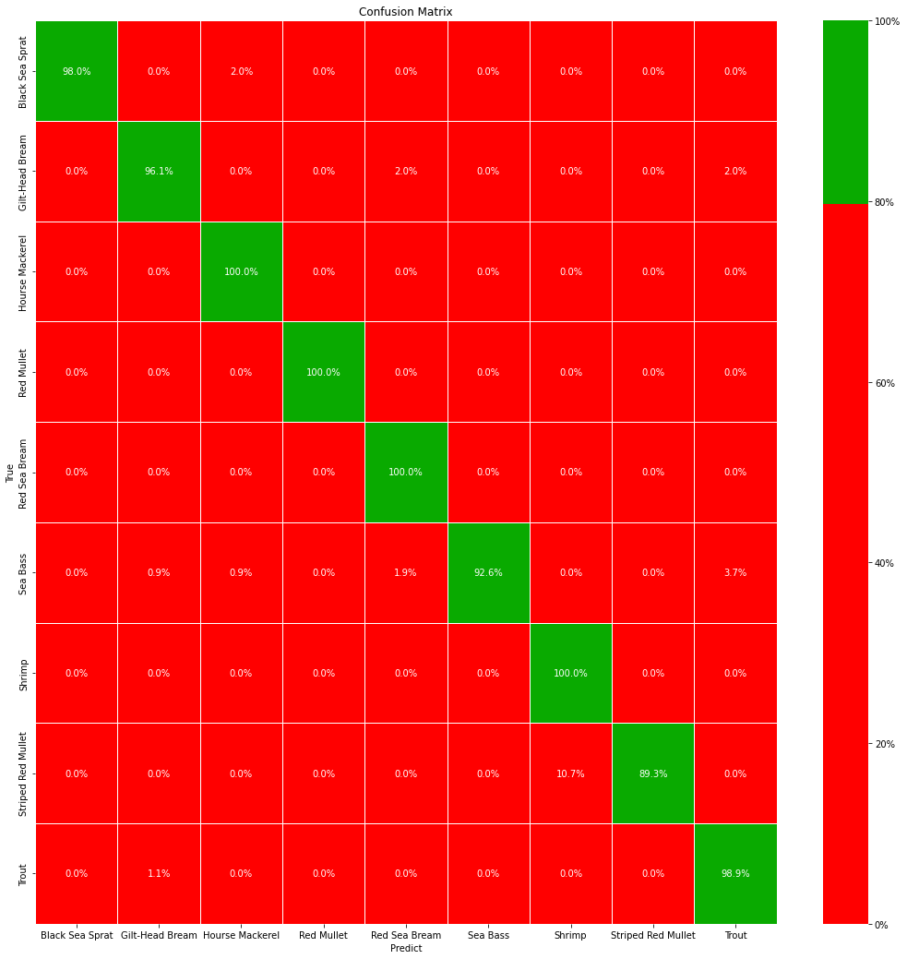
VII. RESEARCH RESULT
CONFUSION MATRIX:
A simple but powerful tool for evaluating the performance of classification algorithms.
It provides a clear summary of the prediction results and can be used to calculate various performance metrics.

Slide 13
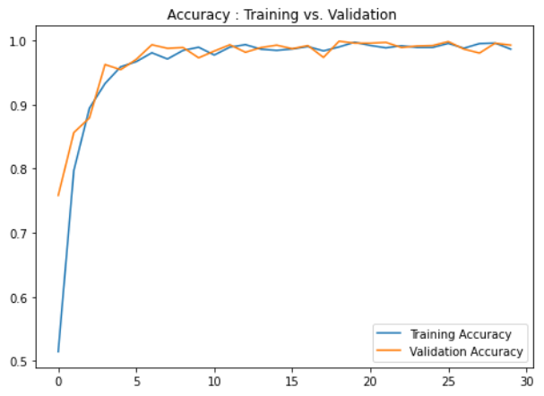
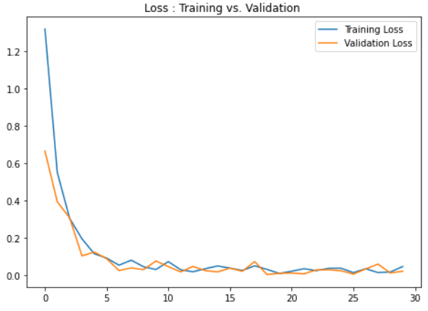
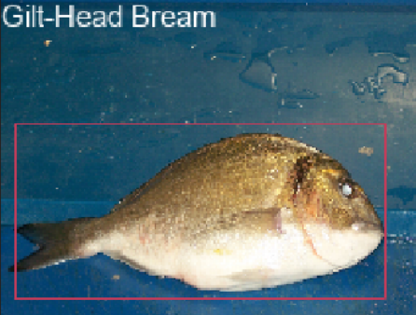
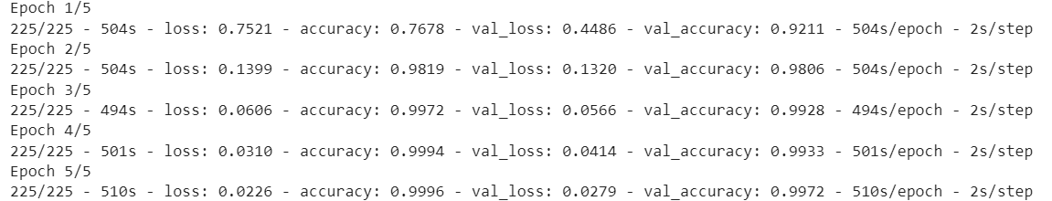
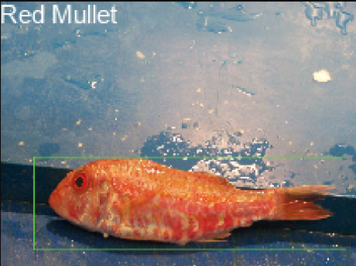
VII. RESEARCH RESULT

Slide 14
VIII. REFERENCES
Erlend Olsvik, Christian MD Trinh, Kristian Muri Knausgard, Arne ˚ Wiklund, Tonje Knutsen Sørdalen, Alf Ring Kleiven, Lei Jiao, and Morten Goodwin. Biometric fish classification of temperate species using convolutional neural network with squeeze-and-excitation. In Advances and Trends in Artificial Intelligence. From Theory to Practice: 32nd International Conference on Industrial, Engineering and Other Applications of Applied Intelligent Systems, IEA/AIE 2019, Graz, Austria, July 9–11, 2019, Proceedings 32, pages 89–101. Springer, 2019.
Muhammad Naufal Rachmatullah and Iping Supriana. Low resolution image fish classification using convolutional neural network. In 2018 5th International Conference on Advanced Informatics: Concept Theory and Applications (ICAICTA), pages 78–83. IEEE, 2018.
Esra Kaya, I Saritas, and S Tasdemir. Classification of three different fish species by artificial neural networks using shape, color and texture properties. In 7th International Conference on Advanced Technologies, 2017.
R Vinayakumar, KP Soman, and Prabaharan Poornachandran. Applying convolutional neural network for network intrusion detection. In 2017 International Conference on Advances in Computing, Communications and Informatics (ICACCI), pages 1222–1228. IEEE, 2017.
K Vandith Sreenivas, M Ganesan, and R Lavanya. Classification of arrhythmia in time series ecg signals using image encoding and convolutional neural networks. In 2021 Seventh International conference on Bio Signals, Images, and Instrumentation (ICBSII), pages 1–6. IEEE, 2021.
Sukanya Sudarsanan and J Aravinth. Classification of heart murmur using cnn. In 2020 5th International Conference on Communication and Electronics Systems (ICCES), pages 818–822. IEEE, 2020. [11] R Bhuvaneswari and S Ganesh Vaidyanathan. Classification and grading of diabetic retinopathy images using mixture of ensemble classifiers. Journal of Intelligent & Fuzzy Systems, 41(6):7407–7419, 2021.

Slide 15
THANK YOU

